Slide 1
Create a Report with Parameter
Lecturer: Ngo Huy Bien
Software Engineering Department
Faculty of Information Technology
VNUHCM - University of Science
Ho Chi Minh City, Vietnam
nhbien@fit.hcmus.edu.vn

Slide 2

Objectives

Slide 3

Contents

Slide 4

References
Brian Larson (2017). Microsoft SQL Server 2016 Reporting Services. McGraw-Hill Education.

Slide 5
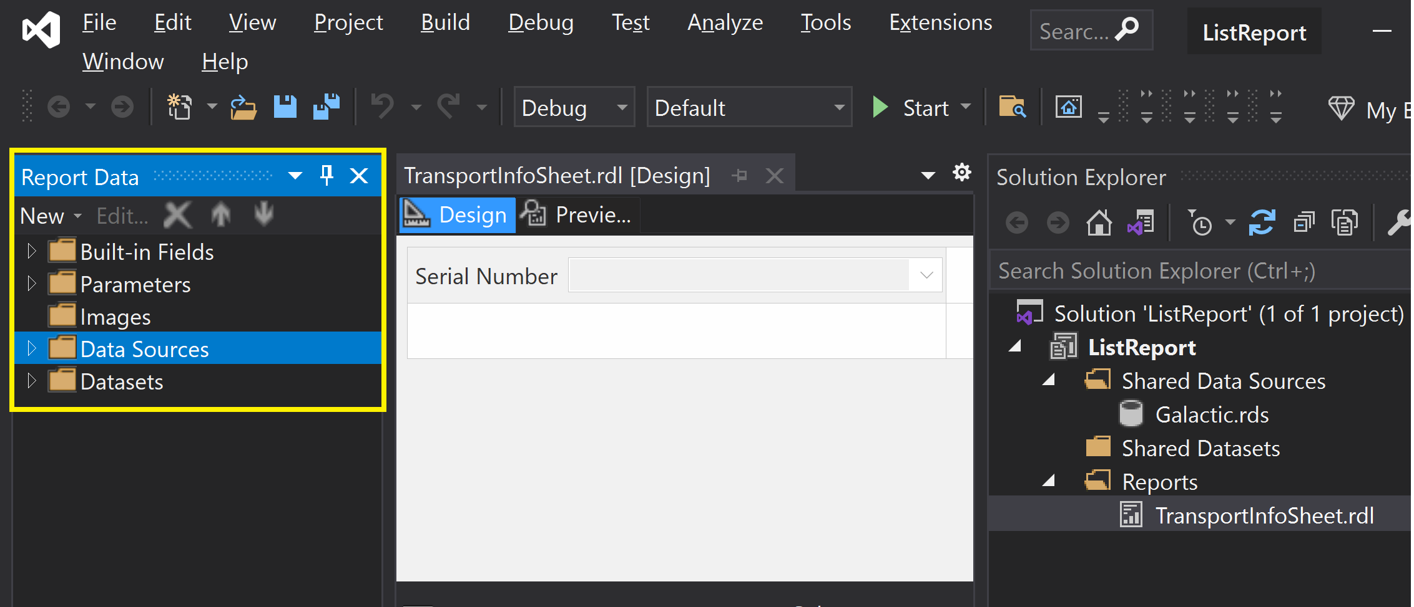
1. Open Report Data Pane
Turn on Caps Lock
CTRL + ALT + D

Slide 6
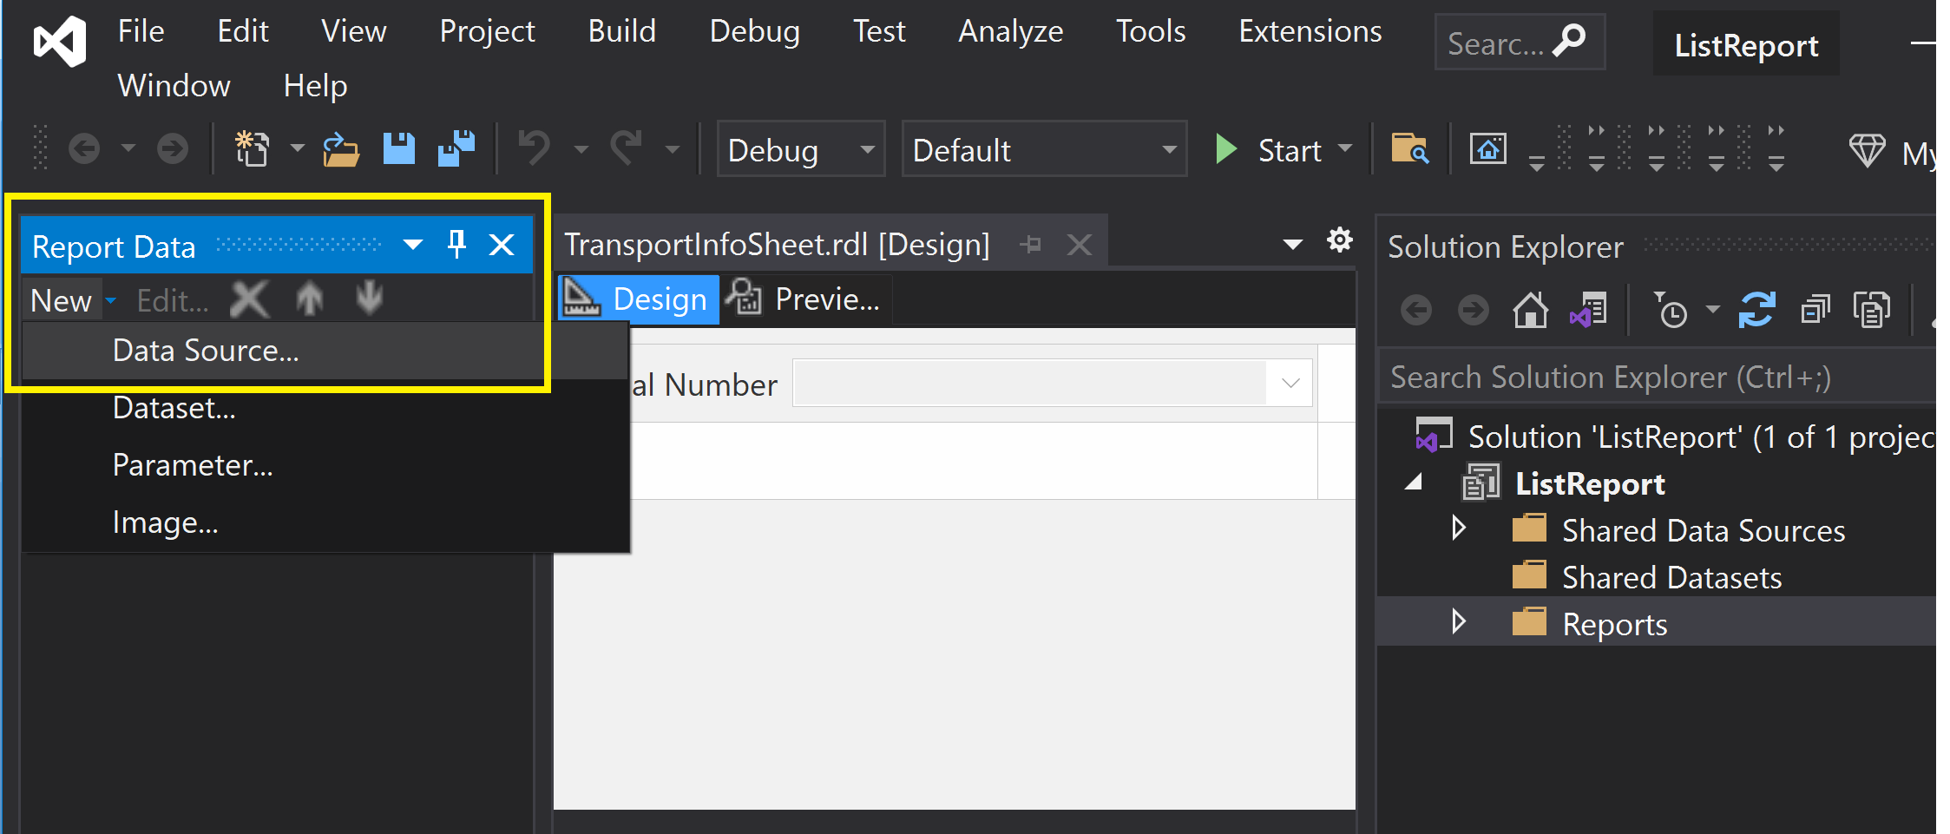
2. Add a Report Data Source (I)
This data source belongs to the report.

Slide 7
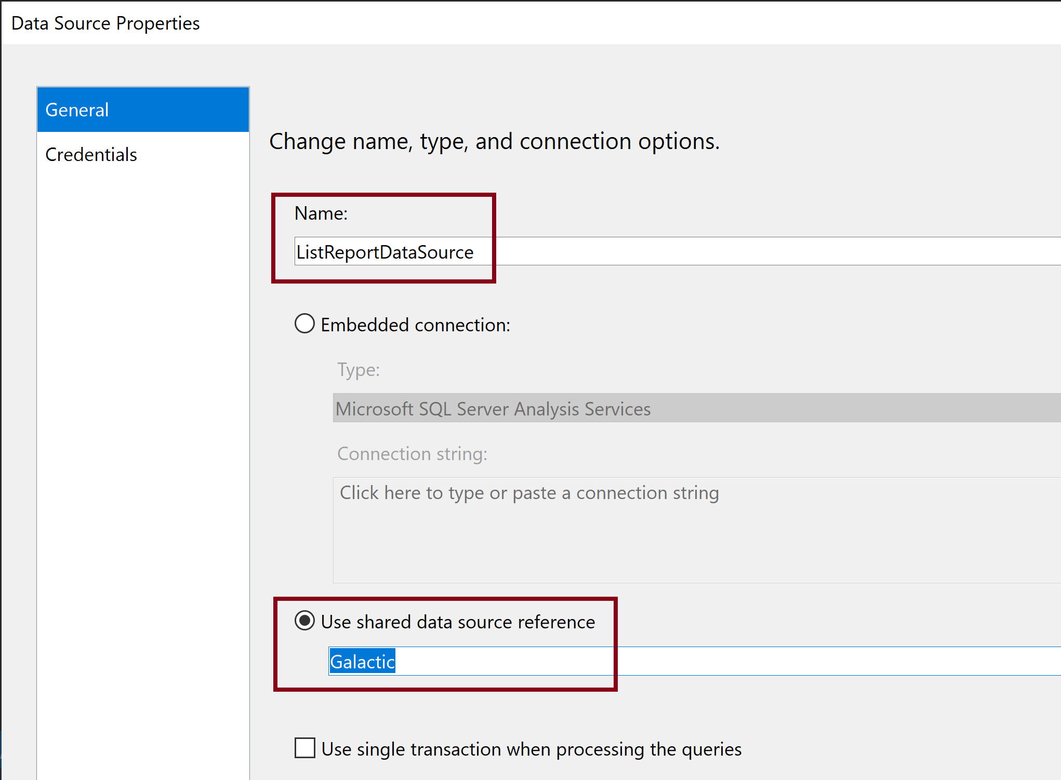
3. Add a Report Data Source (II)

Slide 8
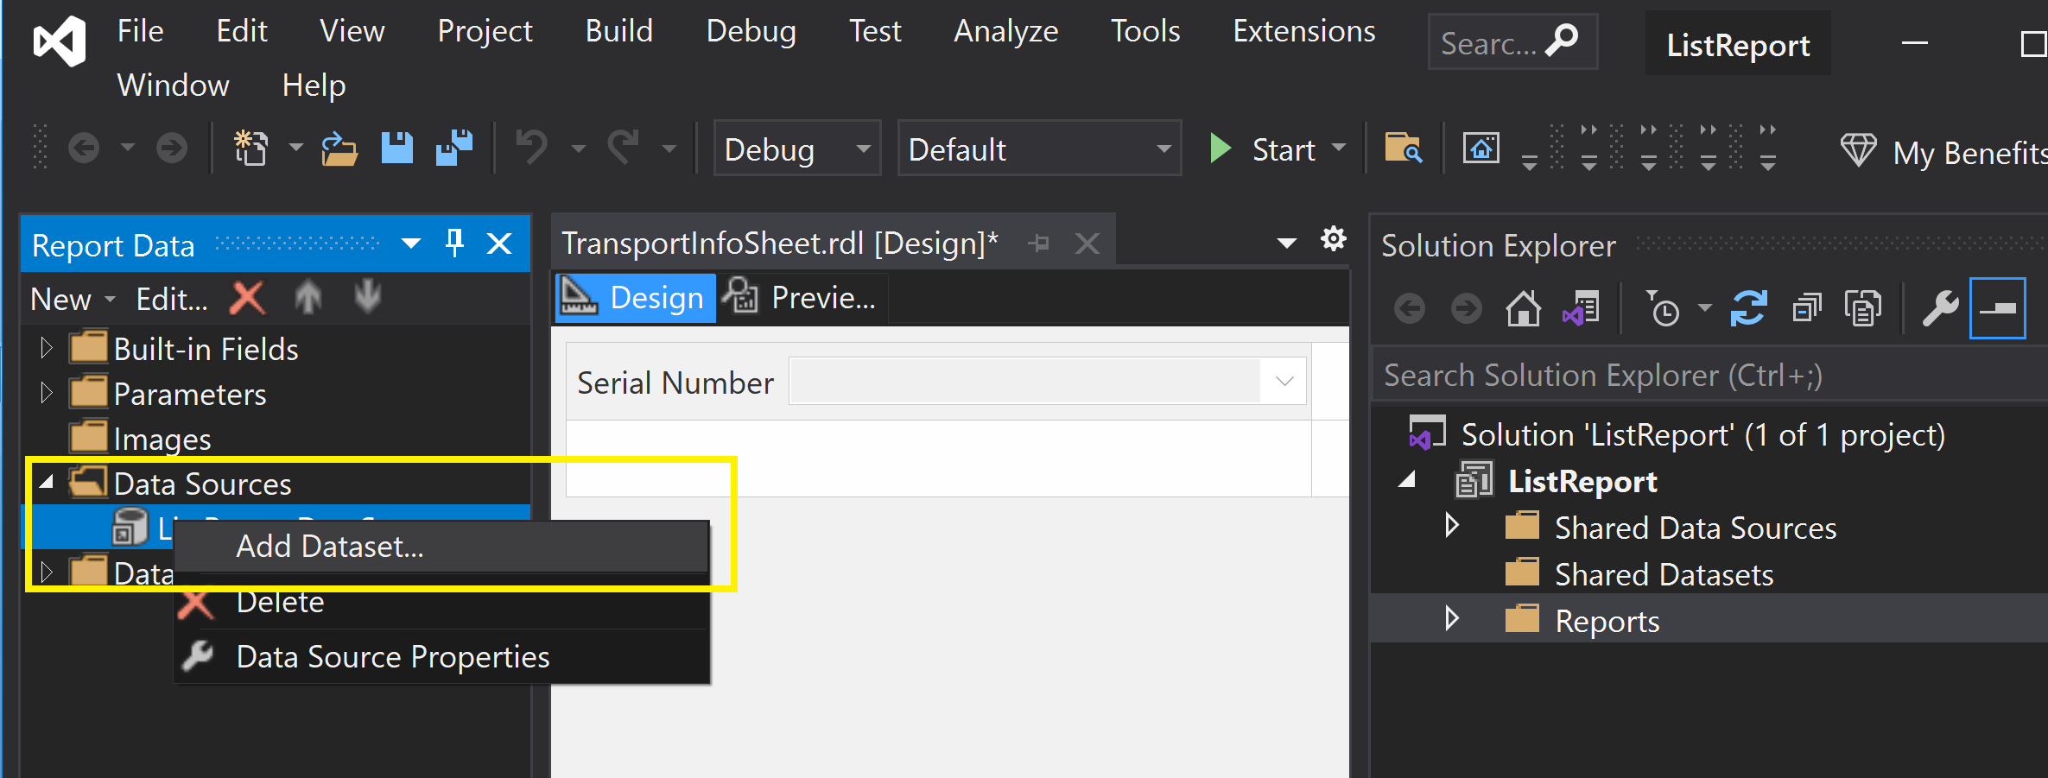
4. Add the First Data Set (I)
This data set belongs to the report.

Slide 9
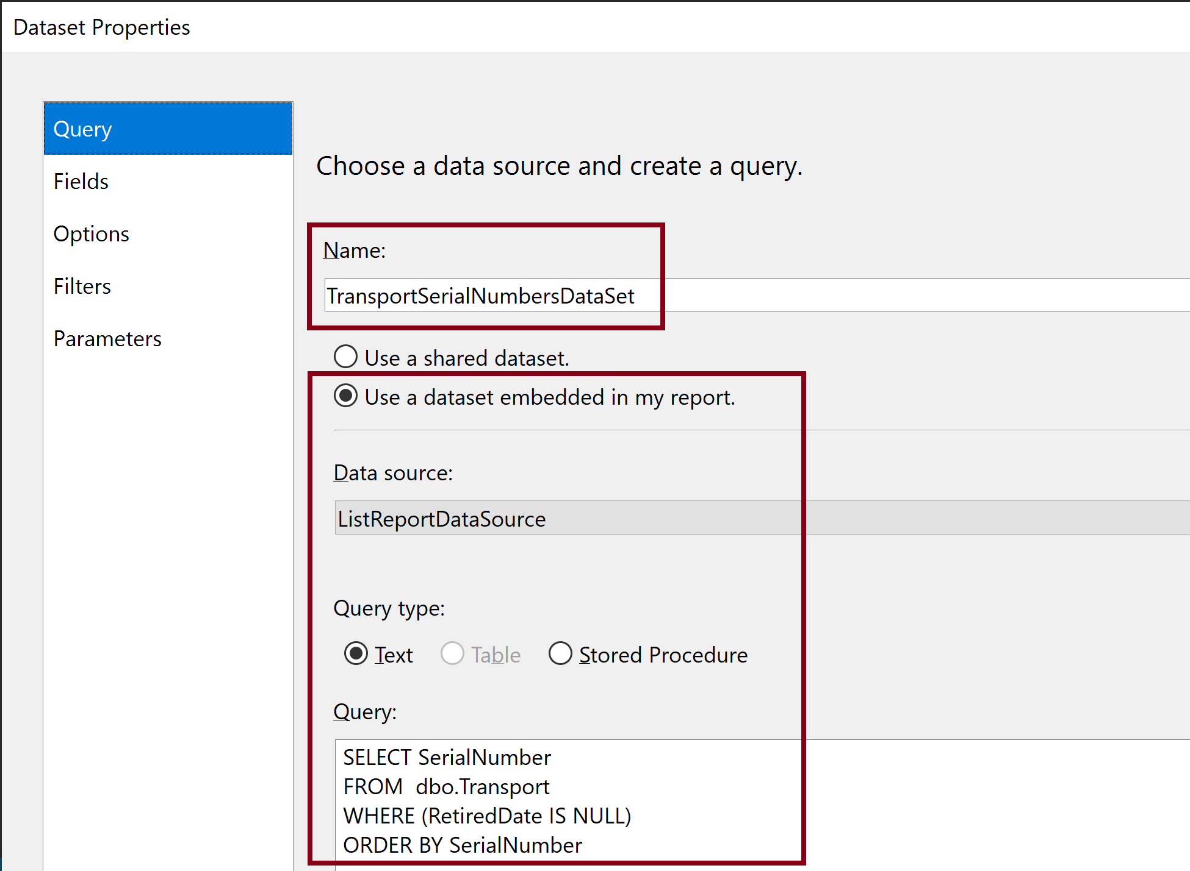
5. Add the First Data Set (II)

Slide 10
6. Add the Second Data Set (I)
This data set belongs to the report.

Slide 11
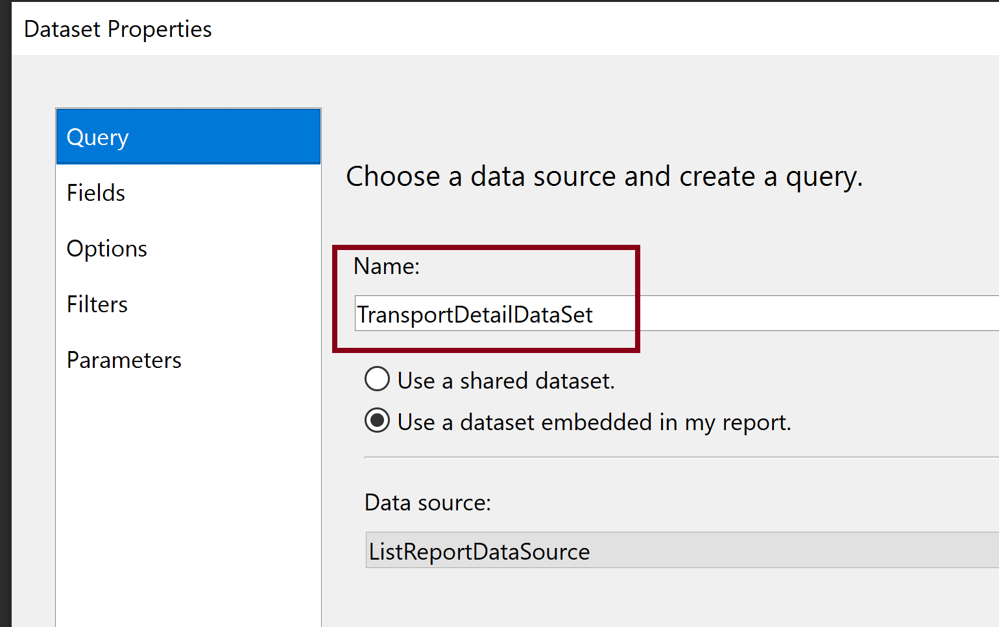
7. Add the Second Data Set (II)

Slide 12
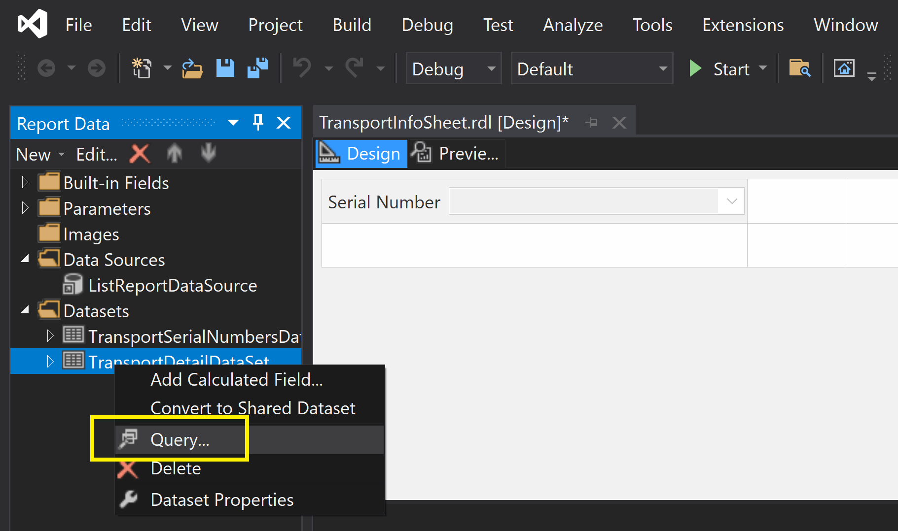
8. Open Query Designer

Slide 13
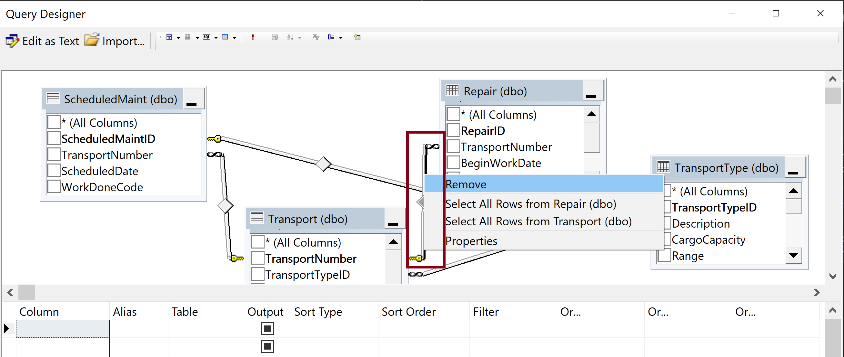
9. Remove a Link (Remove INNER JOIN)
Right-click the link between the Transport and the Repair tables, and then select Remove from the context menu.

Slide 14
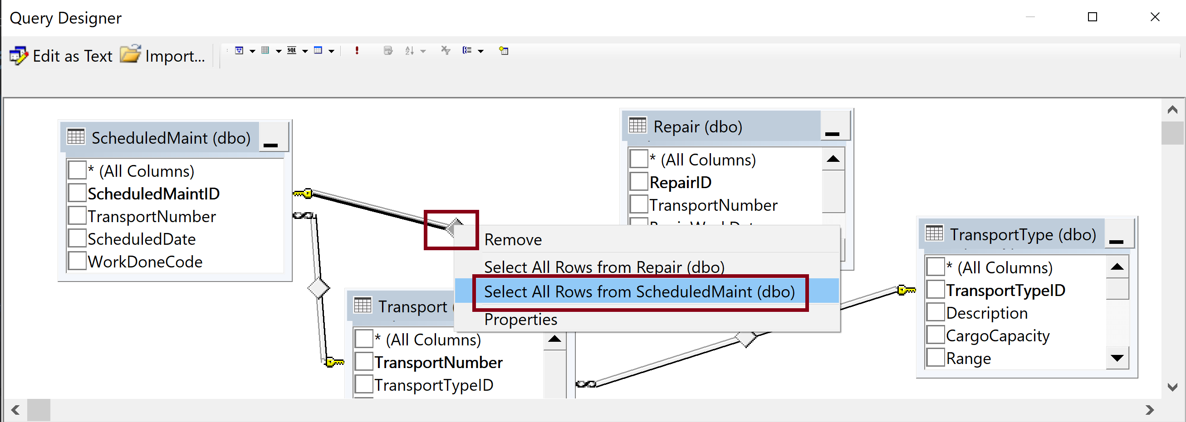
10. Select All Rows (OUTER JOIN)
Right-click the diamond in the middle of the link between the Repair table and the ScheduledMaint table.
Choose Select All Rows from ScheduledMaint in the context menu.

Slide 15
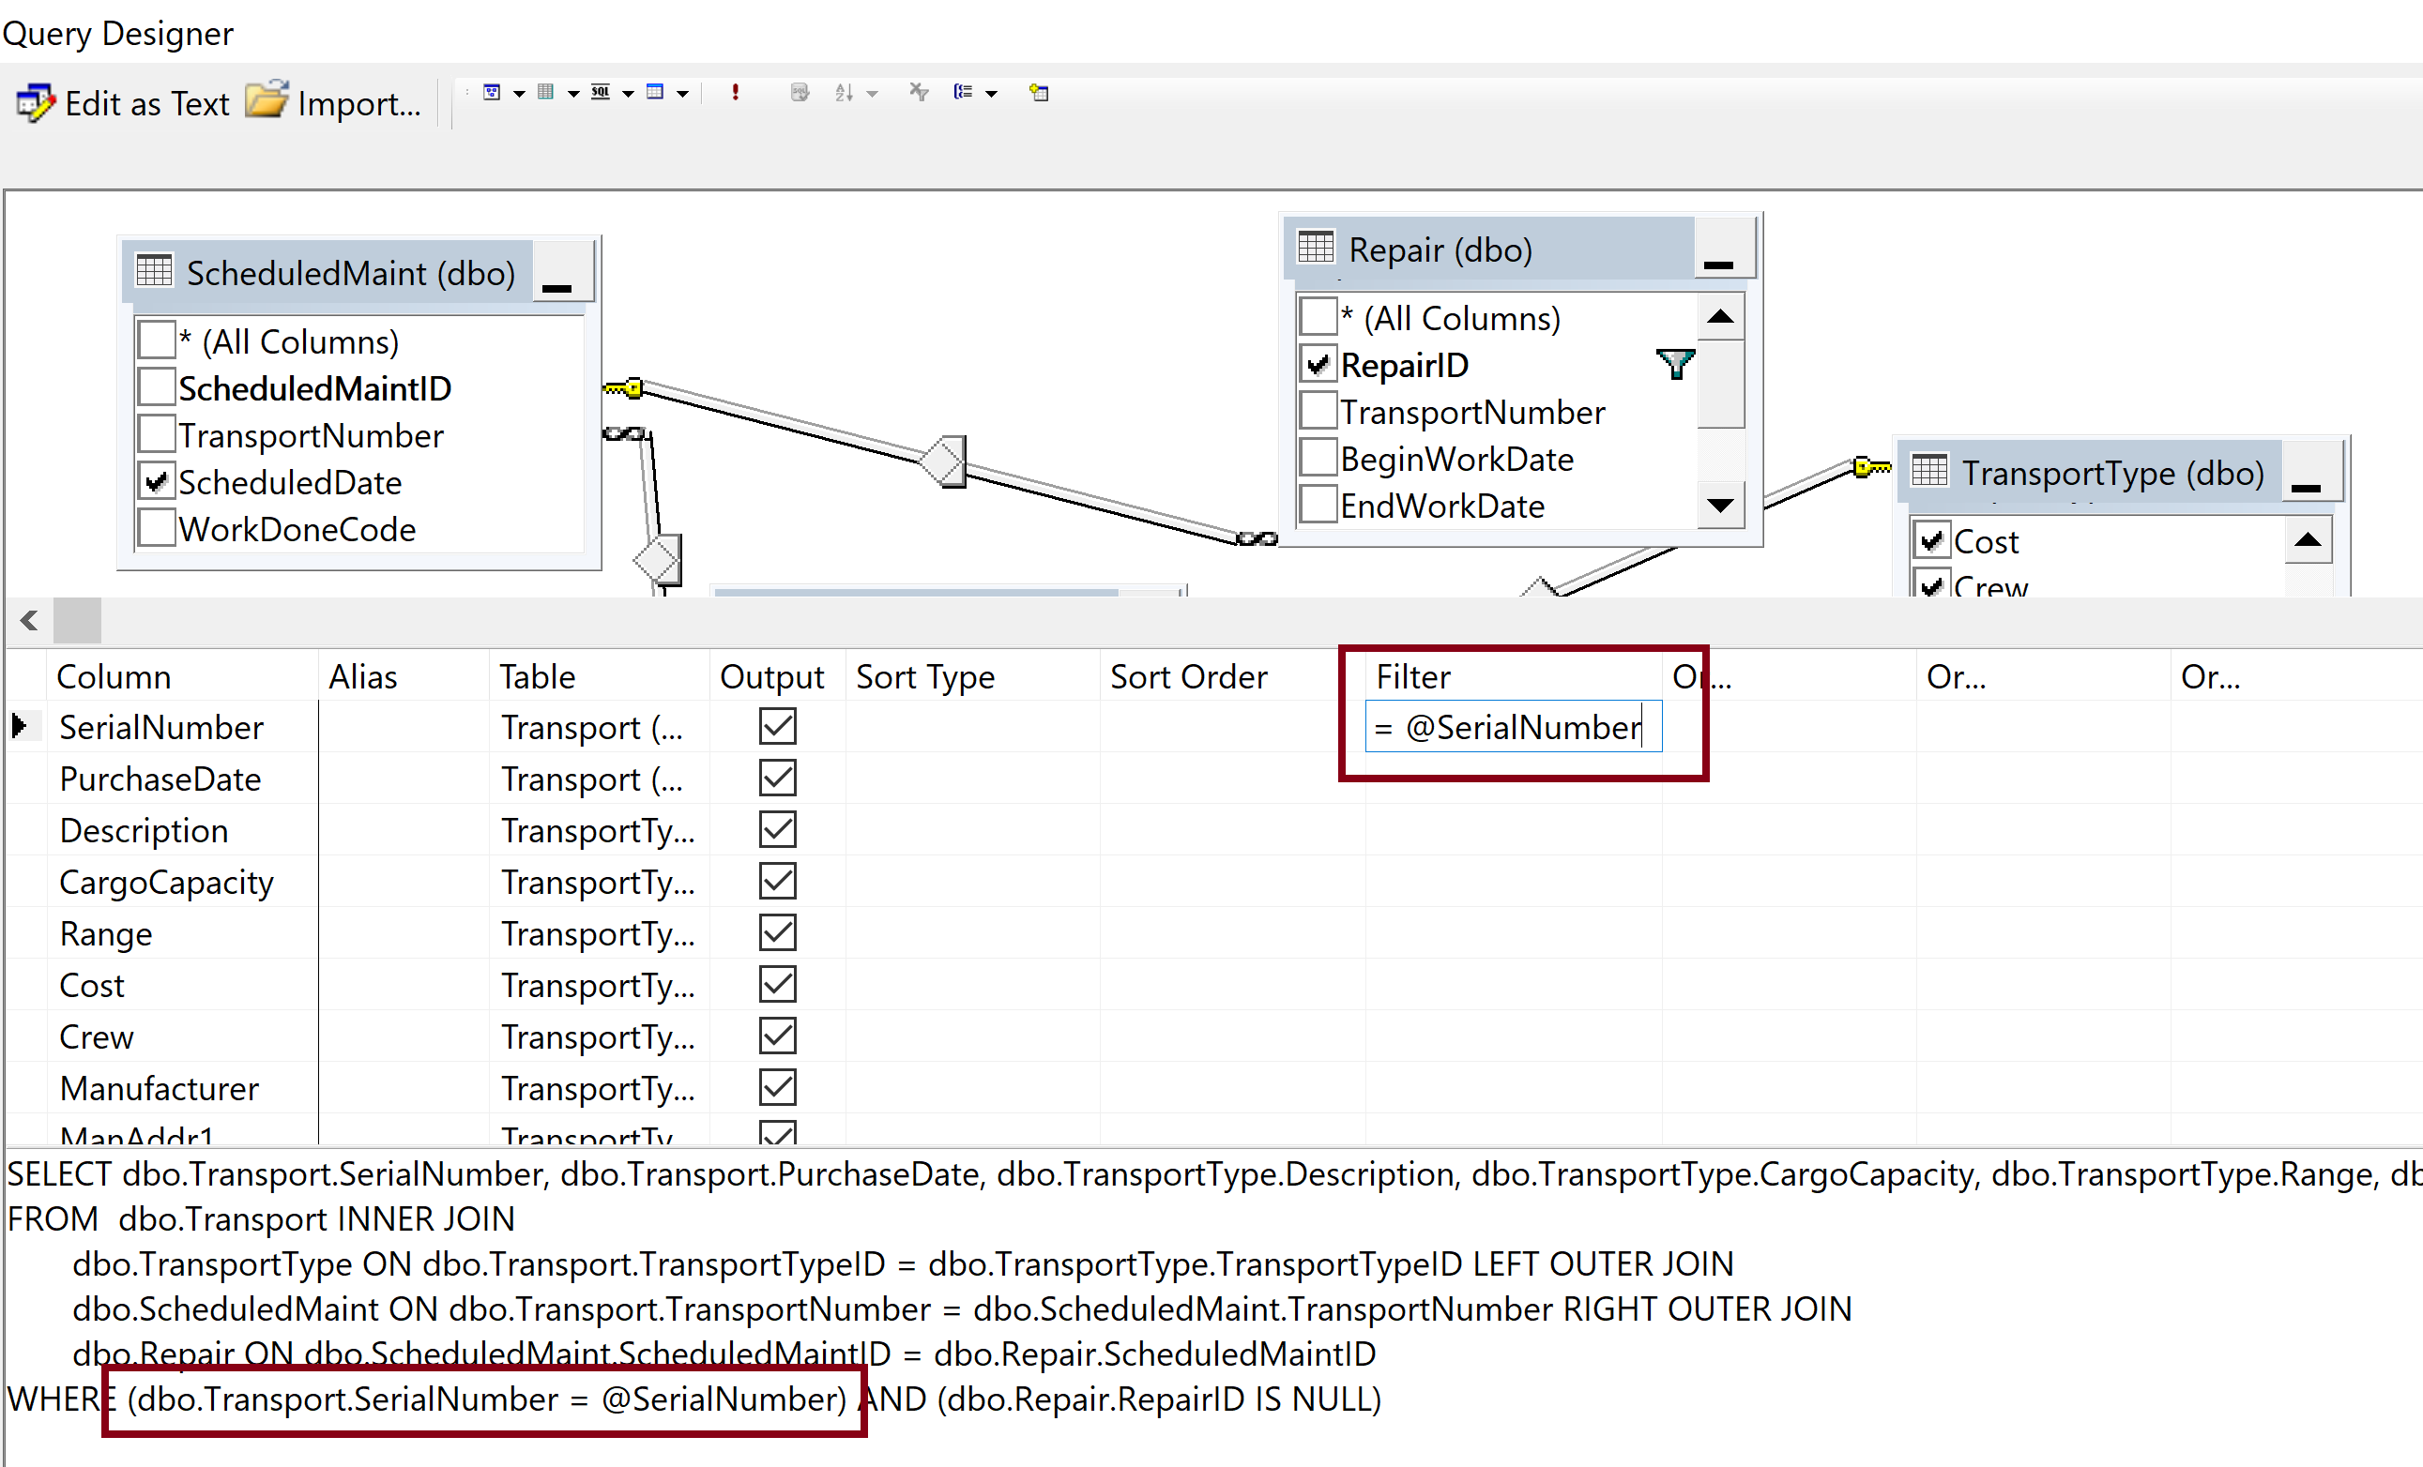
11. Add a Parameter
This parameter value shall be retrieved from the first data set.

Slide 16
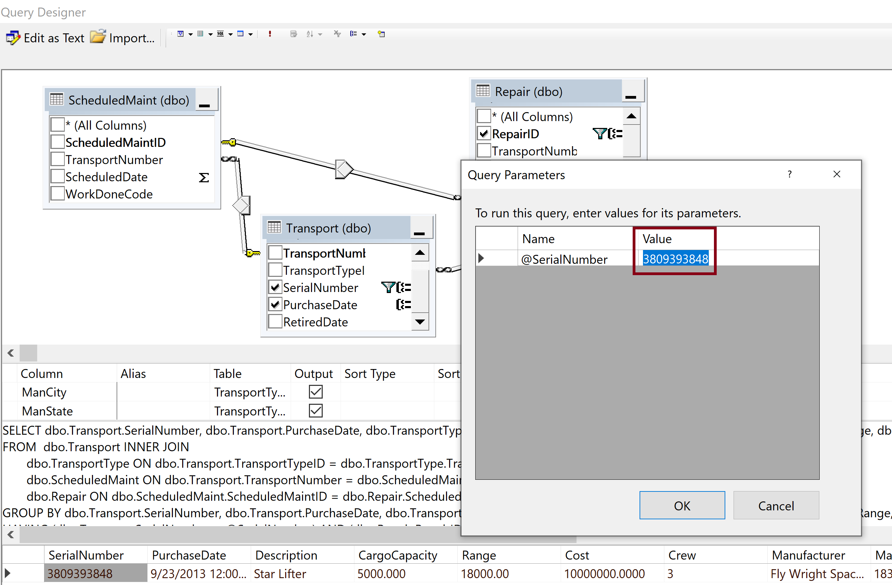
12. Execute a Query with Parameter

Slide 17
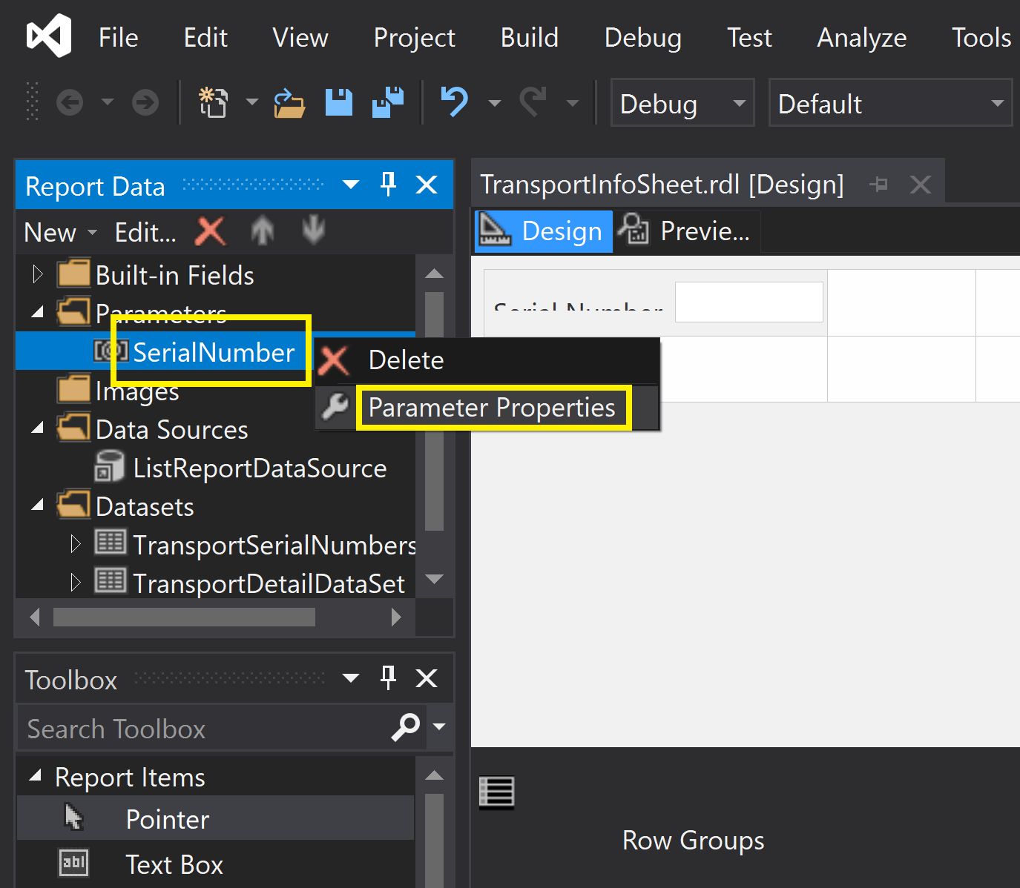
12. Configure Parameter Properties

Slide 18
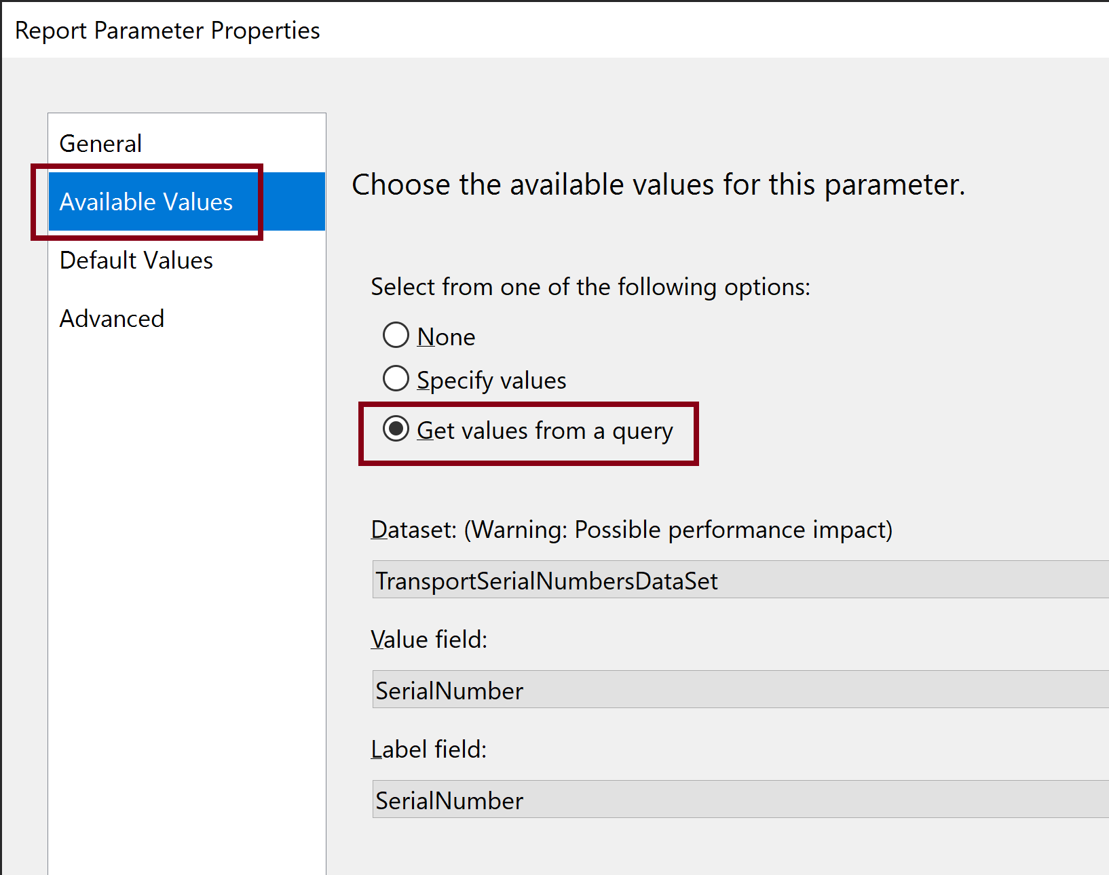
13. Set Available Values for Parameter

Slide 19
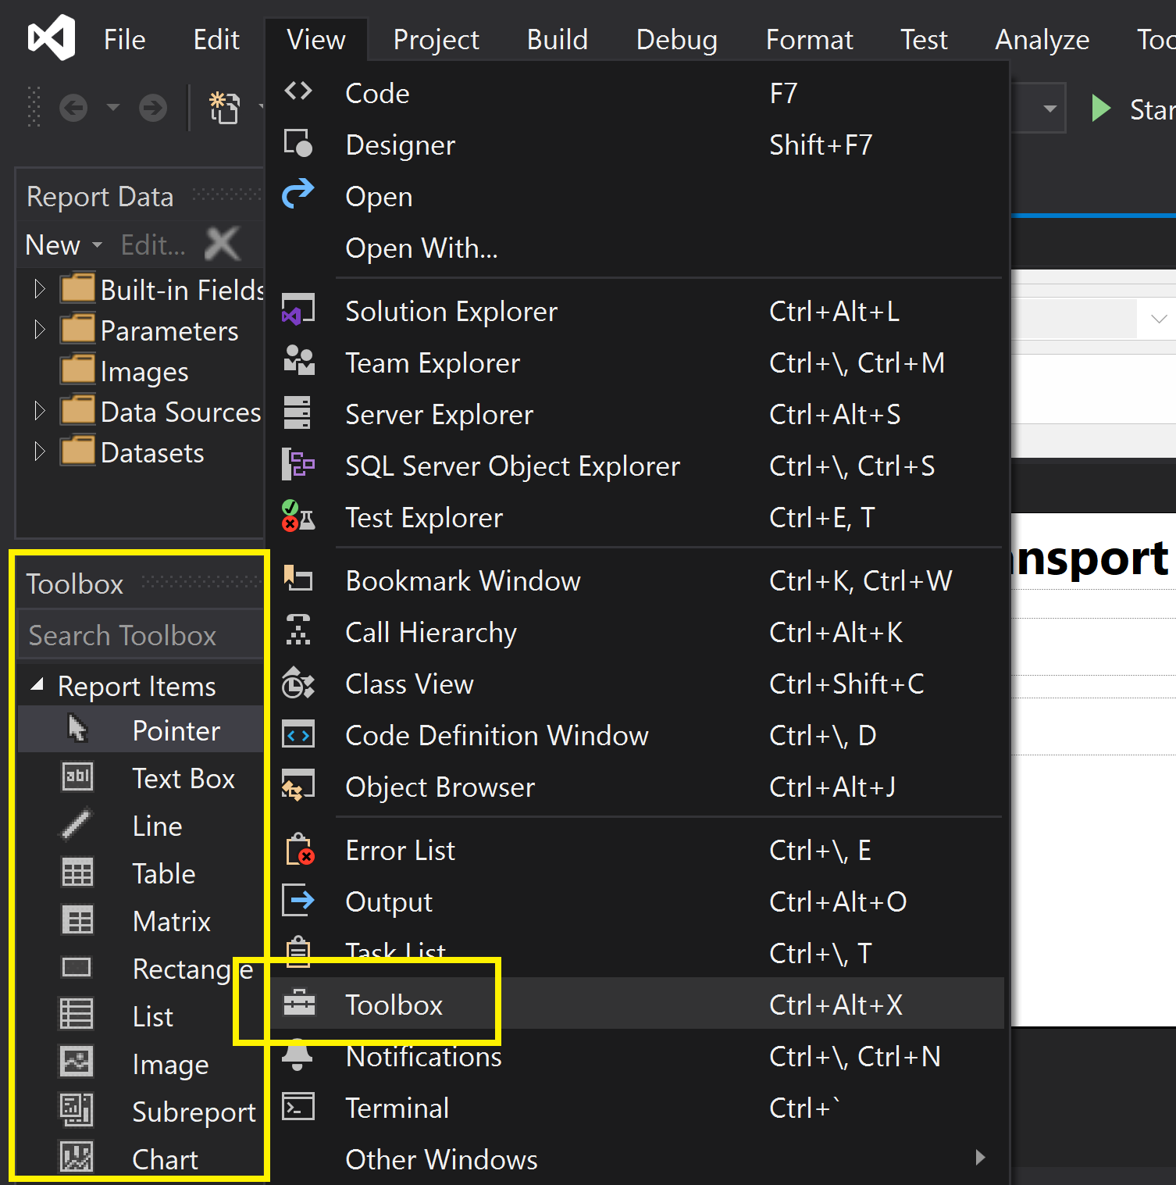
14. Open Toolbox

Slide 20
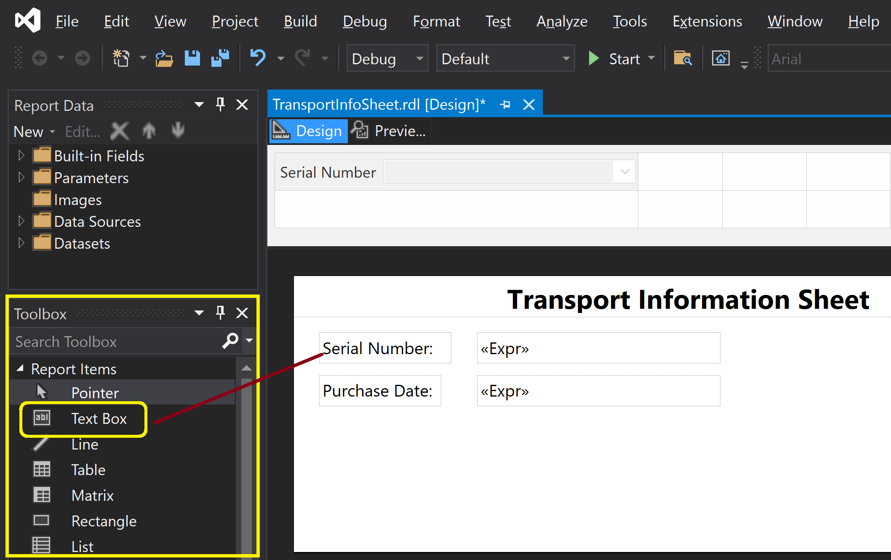
15. Add a Text Box to the Report

Slide 21
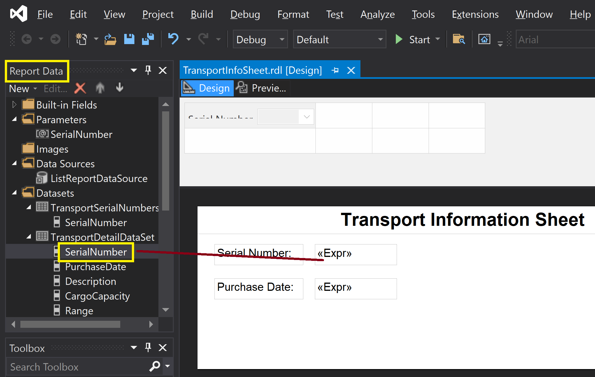
16. Add a Field to the Report
In the Report Data window, expand the TransportDetail dataset, if necessary.
Drag the SerialNumber field from the Report Data window, and place it to the report.

Slide 22
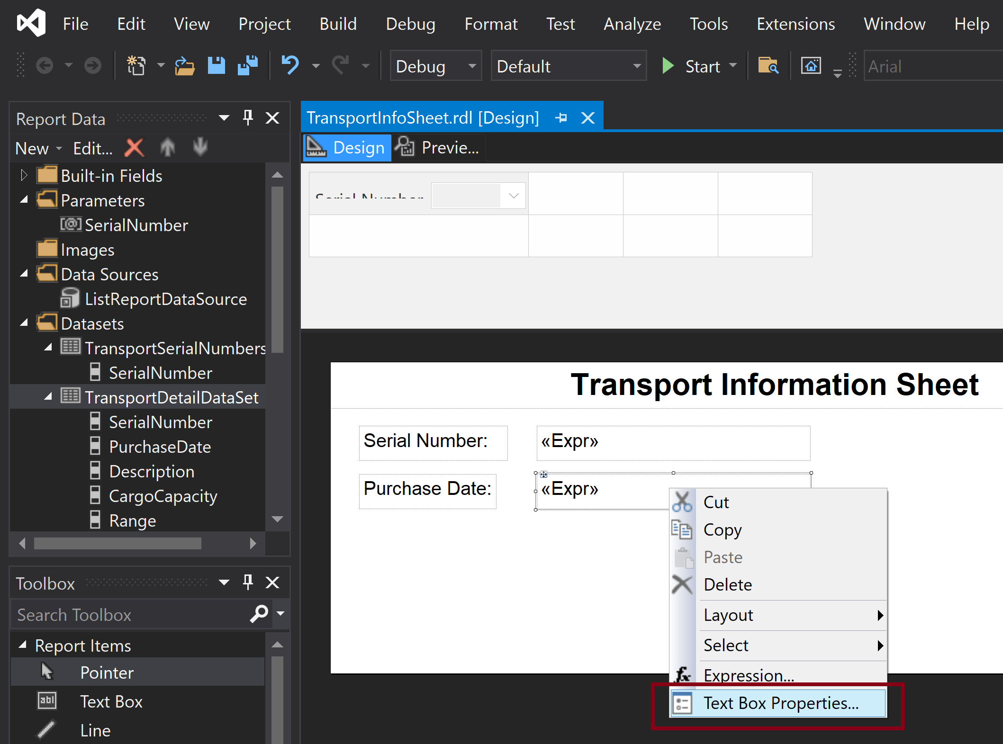
17. Configure Field Properties

Slide 23
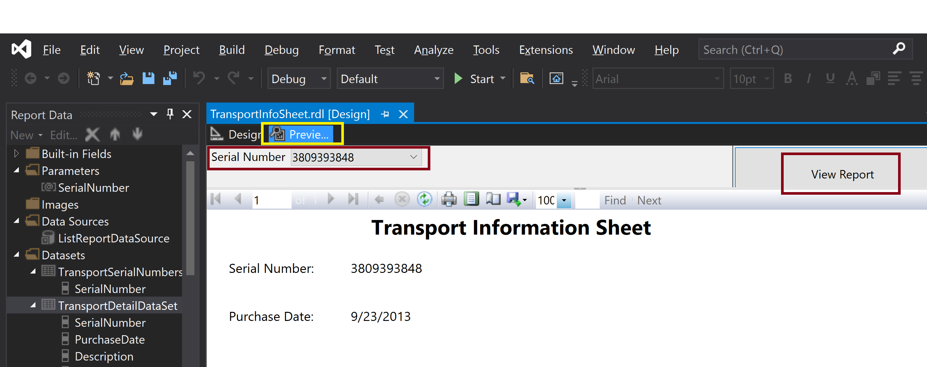
18. Preview the Report

Slide 24
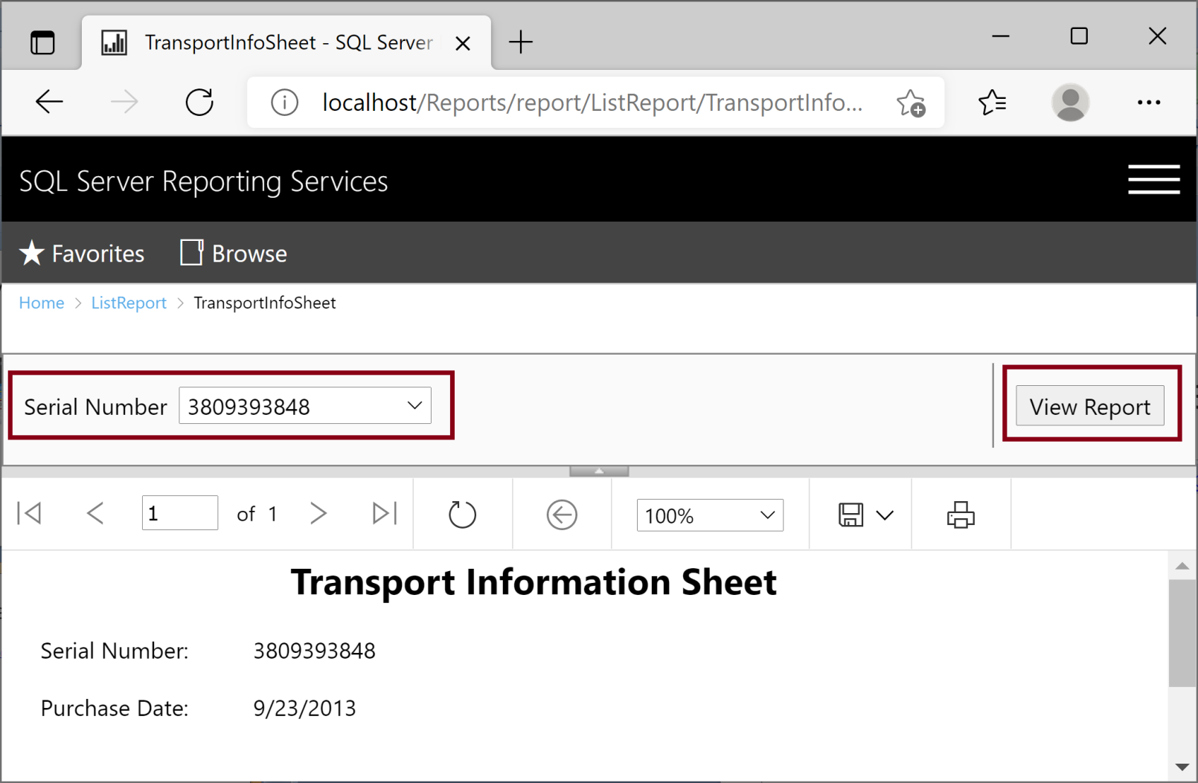
19. Test the Deployed Report
http://localhost/Reports/report/ListReport/TransportInfoSheet

Slide 25

Thank You & See You Again

